Slide 1





BINF III/C
MAY 2024
TECH-TRIBE
EMPLOYEE SKILLS AND CAREER DEVELOPMENT
Let's get started
Software engineer

Slide 2



AGENDA
Introduction
Project Kickoff Overview
Github Introduction
Project Demo

Slide 3
Before we go, let's list down our
project goals and relevance.
PROJECT KICKOFF
Introduction | Introduction | Introduction
Team members: | Project Goals | Project Relevance
Armela Elezaj | The primary goal is to streamline HR processes and tasks | Industry demand Organizational efficiency
Alesja Vrapi | Create a centralized platform for storing and managing employee data | Cost savings Compliance and risk mitigation
Endri Kena | Implement tools and features for tracking employee performance | Employee experience Educational relevance
Megi Kamberi | Eliminating manual data entry and reducing costs | Data-driven decision making
Romina Zeneli | Prioritize user experience (UX) design to create an intuitive and user-friendly interface | Scalability and adaptability
1
2
3

Slide 4


PROJECT OVERVIEW
Tech-Tribe
Project Name: Employee Skills And Career Development
2. Objective: To create and affective employee skills and career development platform.
3. Scope: Employee management, attendance tracking, leave management, generating reports, performance evaluations, and communication tools.
4. Target Audience: HR and employees of different organizations.
5. Key Features: Skills Assessment, Performance Review, Career Path.

Slide 5
PROJECT OVERVIEW - HRMS
Tech-Tribe
Technologies Used: Angular, Node Js with Express Framework, Mongo DB, Figma, Github etc.
2. Development Timeline: 2 Months
3. Future Enhancements: Implementing Training and Learning, Certificates tracking, Coaching Programs etc.
4. Project Impact: Creating a dedicated job marketplace which will transform talent management and foster culture of continuous learning and progress inside businesses.

Slide 6

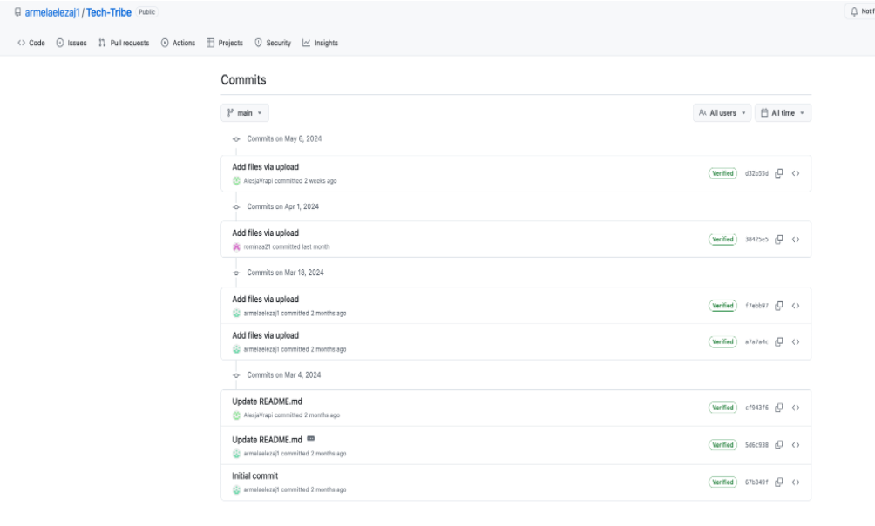
GITHUB RESPOSITORY:
TECH-TIBE

Slide 7
TARGET AUDIENCE
OUR EMPLOYEE SKILLS AND CAREER DEVELOPMENT PLATFORM IS DESIGNED TO BENEFIT HR AND EMPLOYEES, OFFERING SOLUTIONS TO ENHANCE WORKFORCE PRODUCTIVITY AND ENGAGEMENT.
HR PROFESSIONALS BENEFITS:
EFFICIENT TALENT MANAGEMENT: OPTIMIZE EMPLOYEE SKILLS AND ROLES.
IMPROVED ENGAGEMENT: BOOST JOB SATISFACTION.
DATA-DRIVEN INSIGHTS: IDENTIFY SKILL GAPS AND TRAINING NEEDS.
EMPLOYEES BENEFITS:
CAREER DEVELOPMENT: PERSONALIZED CAREER PATHWAYS AND SKILL ENHANCEMENT.
ACCESS TO OPPORTUNITIES: VISIBILITY INTO INTERNAL JOB OPENINGS.
CONTINUOUS LEARNING: EMPOWERMENT THROUGH SKILL TRACKING AND DEVELOPMENT.
ORGANIZATIONAL BENEFITS
EFFECTIVE TALENT DEVELOPMENT: ALIGN SKILLS WITH ORGANIZATIONAL GOALS.
INCREASED RETENTION: BETTER CAREER DEVELOPMENT OPPORTUNITIES.
ENHANCED PRODUCTIVITY: MATCH EMPLOYEES TO SUITABLE ROLES.

Slide 8
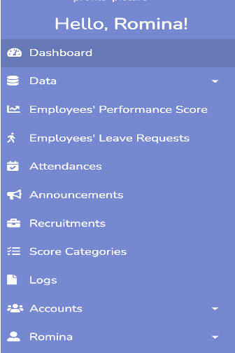

FEATURES
●Skills Assessment: Employees can assess their current skills and identify areas for improvement using our comprehensive skills assessment tool.
●Career Path Planning: Our platform helps employees explore different career paths within the organization and create personalized career development plans.
●Feedback and Performance Reviews: Employees receive ongoing feedback and performance reviews, including feedback on skill development and career progression.

Slide 9
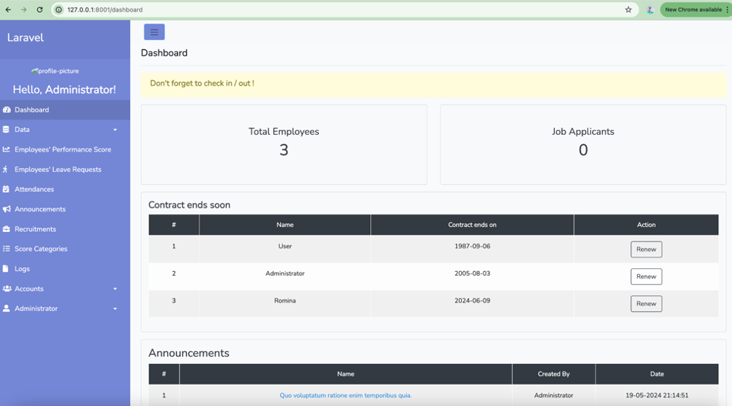
DASHBOARD OVERVIEW

Slide 10
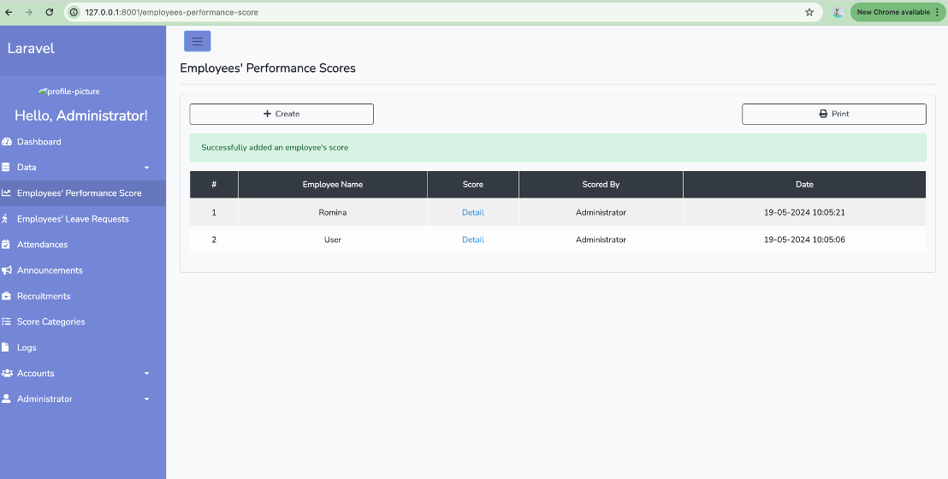
EMPLOYEE’S PERFORMANCE VIEW

Slide 11
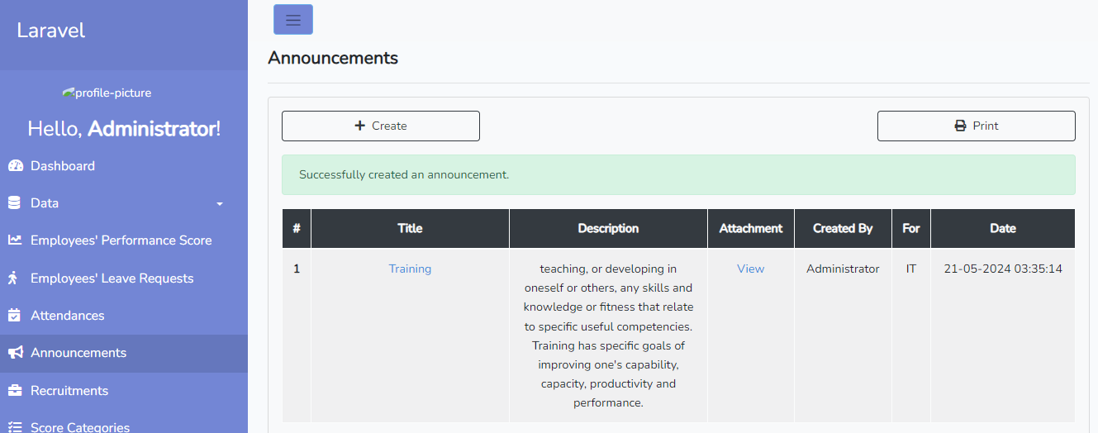
ANNOUNCEMENTS FROM EMPLOYEE’S VIEW

Slide 12
CODE CHALLANGES
THROUGHOUT THE DEVELOPMENT PROCESS, WE ENCOUNTERED SEVERAL CHALLENGES, INCLUDING:
INTEGRATING THIRD-PARTY APIS FOR SKILLS ASSESSMENT AND LEARNING RESOURCES.
ENSURING DATA SECURITY AND PRIVACY COMPLIANCE.
OPTIMIZING PLATFORM PERFORMANCE FOR SCALABILITY AND RESPONSIVENESS.
ITERATING ON USER FEEDBACK TO REFINE FEATURES AND IMPROVE USABILITY.
TO OVERCOME THESE CHALLENGES, WE ADOPTED AN AGILE DEVELOPMENT APPROACH, CONDUCTED REGULAR TESTING AND FEEDBACK SESSIONS AND PRIORITIZED CONTINUOUS IMPROVEMENT AND ITERATION.

Slide 13
THANK YOU !

